Slide 1

Customer Shopping Behavior Analysis
Transactional insights from 3,900 purchases across product categories

Slide 2

Project Overview
3,900 Purchases
Key Goals
Transactional data analyzed
Spending patterns, customer segments, product preferences, subscription behavior
Strategic Impact
Guide business decisions with data

Slide 3
Dataset Summary
Key Features
3,900 Rows
37 Missing Values
Demographics: Age, Gender, Location, Subscription
Purchases: Item, Category, Amount, Season, Size, Color
Behavior: Discount, Promo Code, Frequency, Review Rating, Shipping
18 columns
Review Rating column

Slide 4

Exploratory Data Analysis — Python
Load & Explore
Engineer Features
pandas, df.info, describe
age_group, purchase_frequency_days
Clean Data
Load to PostgreSQL
impute missing ratings, standardize cols
write_df.to_sql or COPY
Key stats: Avg age 44, Avg purchase $59.76, Avg rating 3.75. Median imputation for 37 missing Review Ratings.

Slide 5
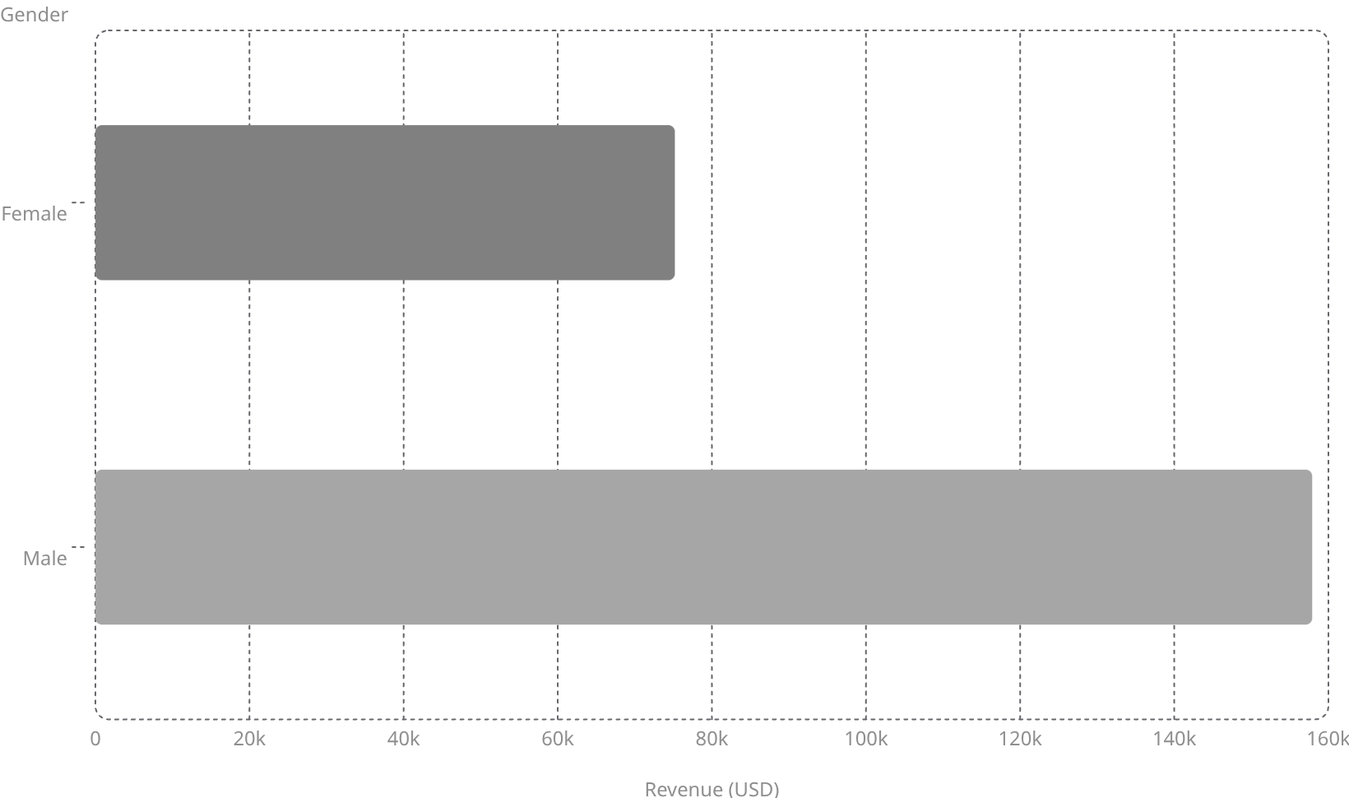
SQL Analysis — Revenue & Products
Top 5 Products by Rating
Gloves — 3.86
Sandals — 3.84
Boots — 3.82
Hat — 3.80
Skirt — 3.78
Express avg $60.48 vs Standard $58.46

Slide 6
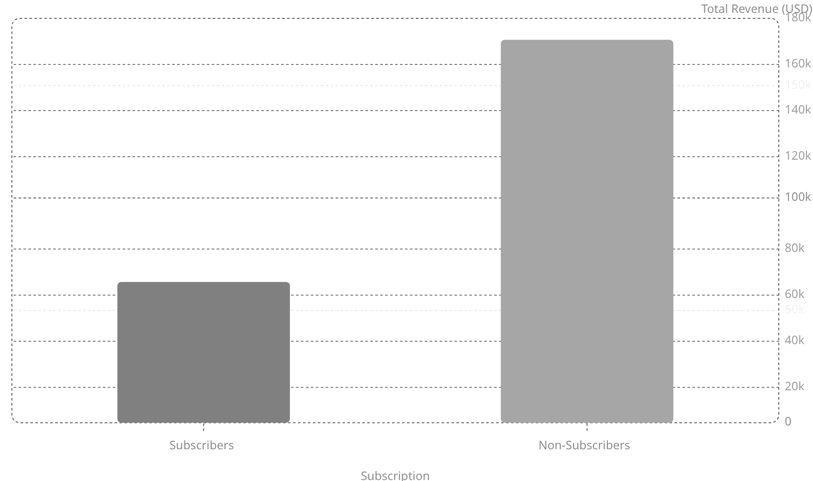
SQL Analysis — Subscribers & Segments
Customer Segments
Loyal
Returning
3,116 customers
701 customers
New
83 customers
Top discount-dependent: Hat (50%), Sneakers (49.66%)

Slide 7
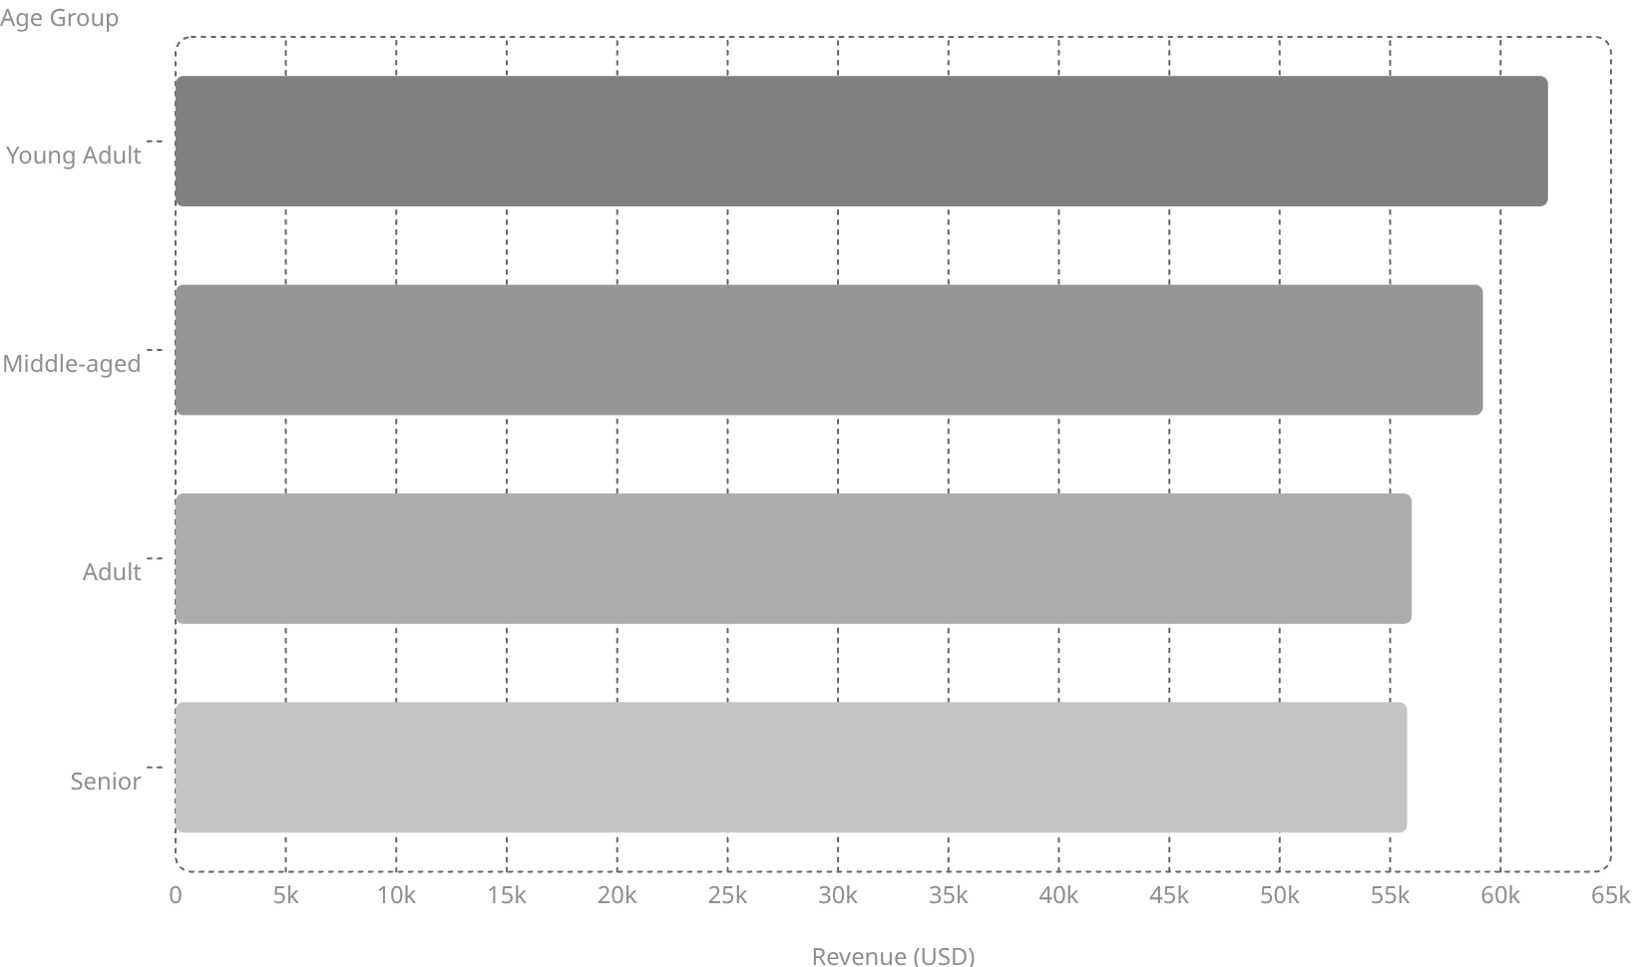
SQL Analysis — Products & Revenue
Top 3 Products per Category
Accessories: Jewelry, Sunglasses, Belt
Clothing: Blouse, Pants, Shirt
Footwear: Sandals, Shoes, Sneakers
Outerwear: Jacket, Coat
Repeat buyers: 958 subscribers vs 2,518 non-subscribers

Slide 8
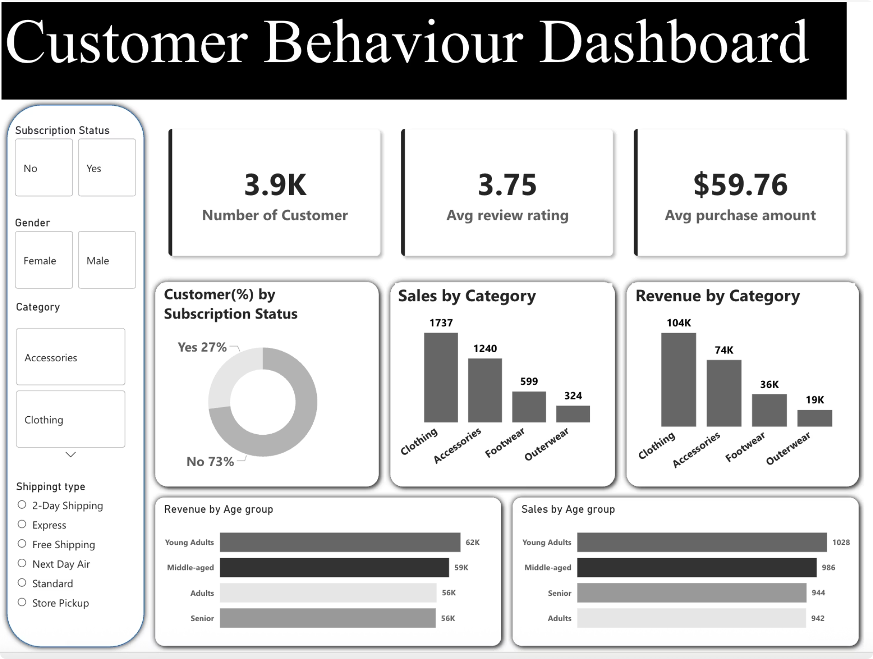
Power BI Dashboard
3.9K
$59.76
3.75
Customers
Avg Purchase
Avg Rating
Filters: Subscription, Gender, Category, Shipping Type. Visuals: Revenue & Sales by Category and Age Group.

Slide 9

Business Recommendations
Boost Subscriptions
Loyalty Programs
Review Discount Policy
Promote exclusive subscriber benefits
Reward repeat buyers toward Loyal segment
Balance sales boosts with margin control
Targeted Marketing
Product Positioning
Focus on high-revenue age groups & express-shipping users
Highlight top-rated & best-selling products in campaigns

